Slide 1
Project Management
Project Management - is the practice of initiating, planning, executing, controlling, and closing the work of a team to achieve specific goals and meet specific success criteria at the specified time (PMBoK).
Project is a temporary endeavor designed to produce a unique product, service or result with a defined beginning and end (usually time-constrained, and often constrained by funding or staffing) undertaken to meet unique goals and objectives, typically to bring about beneficial change or added value.
https://www.pmi.org/about/learn-about-pmi/what-is-project-management

Slide 2
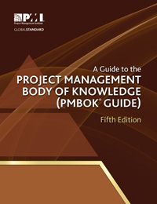
PMBoK
Project Management Body of Knowledge is a set of standard terminology and guidelines for project management.
https://www.pmi.org/pmbok-guide-standards

Slide 3
Project Manager
The project manager is the person assigned by the performing organization to lead the team that is responsible for achieving the project objectives.
The role of a project manager is distinct from a functional manager or operations manager.
Typically the functional manager is focused on providing monitoring-management for a functional or a business unit, and operations managers are responsible for ensuring that business operations are efficient.

Slide 4
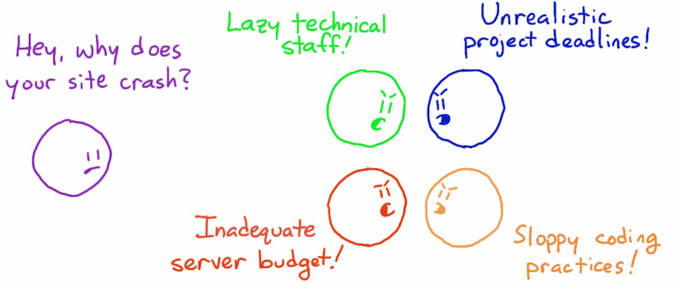







Who is Project Manager

Slide 5
Project
A project can create:
• A product that can be either a component of another item, an enhancement of an item, or an end item
in itself;
• A service or a capability to perform a service (e.g., a business function that supports production or
distribution);
• An improvement in the existing product or service lines (e.g., A Six Sigma project undertaken to reduce
defects); or
• A result, such as an outcome or document (e.g., a research project that develops knowledge that can be
used to determine whether a trend exists or a new process will benefit society).

Slide 6
Project examples
Examples of projects include, but are not limited to:
• Developing a new product, service, or result;
• Effecting a change in the structure, processes, staffing, or style of an organization;
• Developing or acquiring a new or modified information system (hardware or software);
• Conducting a research effort whose outcome will be aptly recorded;
• Constructing a building, industrial plant, or infrastructure; or
• Implementing, improving, or enhancing existing business processes and procedures.

Slide 7
Project, program, portfolio
Portfolio is a collection of projects,
programs, subportfolios managed as a group to achieve strategic objectives.
Programs are grouped within a portfolio and are comprised of subprograms, projects, or other work that are managed in a coordinated fashion in support of the portfolio.
Individual projects that are either within or outside of a program are still considered part of a portfolio.
Although the projects or programs within the portfolio may not necessarily be interdependent or directly related, they are linked to the organization’s strategic plan by means of the organization’s portfolio.

Slide 8
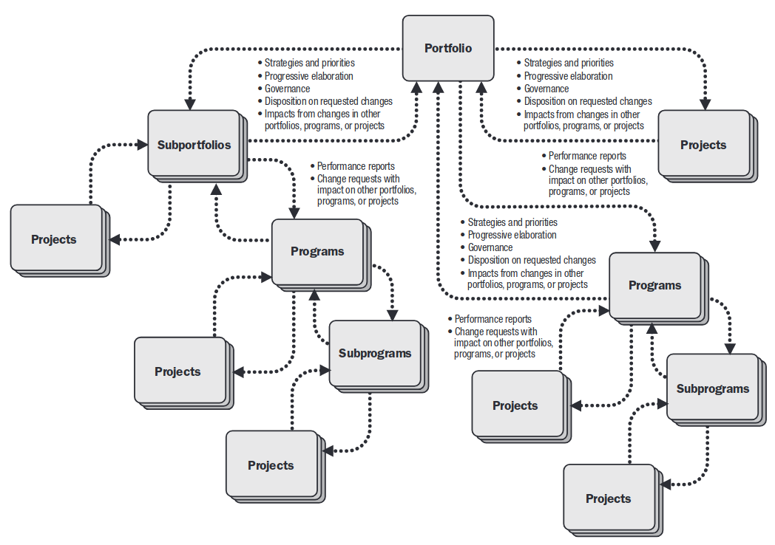

Slide 9
Project stakeholders
Stakeholder is an individual, group, or organization who may affect, be affected by, or perceive itself to be affected by a decision, activity, or outcome of a project.

Slide 10
Project stakeholders
Sponsor is the person or group who provides resources and support for the project and is accountable for enabling success.
Customers are the persons or organizations who will approve and manage the project’s product, service, or result.
Sellers, also called vendors, suppliers, or contractors, are external companies that enter into a contractual agreement to provide components or services necessary for the project.
Business partners are external organizations that have a special relationship with the enterprise, sometimes attained through a certification process.

Slide 11
Project stakeholders
Organizational groups are internal stakeholders who are affected by the activities of the project team.
Functional managers are key individuals who play a management role within an administrative or functional area of the business, such as human resources, finance, accounting, or procurement.
Other stakeholders. Additional stakeholders, such as procurement entities, financial institutions, government regulators, subject matter experts, consultants, and others, may have a financial interest in the project, contribute inputs to the project, or have an interest in the outcome of the project.

Slide 12
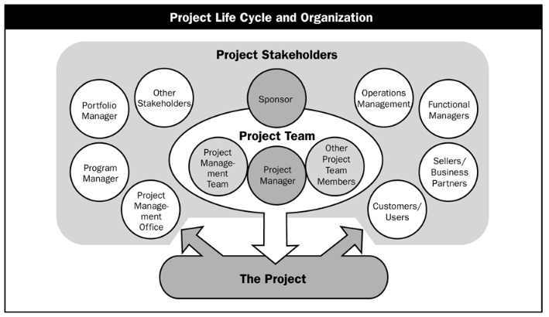

Slide 13
Do I have a project?
Please provide a response to the question below, to see if you are already involved in a project management process (Yes/No):
You are involved in an activity that has a start and finish date.
You know the problem you need to solve.
You require particular resources to undertake the activity.
There is a fixed sum of money that you can use to complete the activity.
There are tasks that need to be achieved within a particular timeframe.
You are in some way responsible for coordinating any of the tasks.
You need help from others to complete the activity.

Slide 14
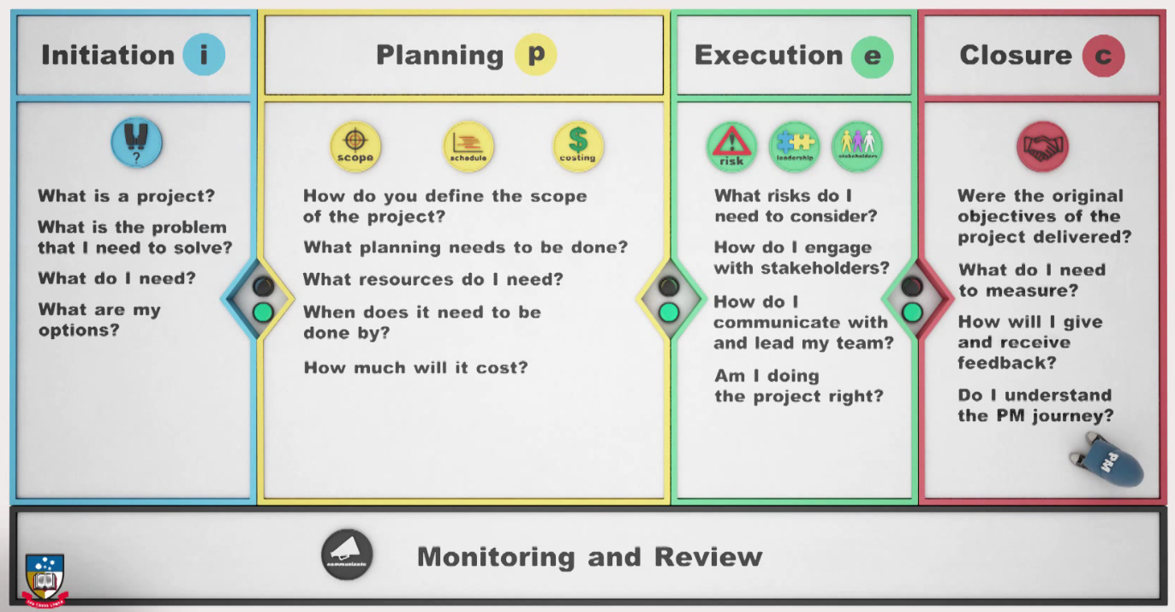
Introduction to Project Management
https://courses.edx.org/courses/course-v1:AdelaideX+Project101x+1T2017/

Slide 15
Project Process Groups
• Initiating,
• Planning,
• Executing,
• Monitoring and Controlling,
• Closing.

Slide 16
Project Process Groups
Managing a project typically includes, but is not limited to:
• Identifying requirements;
• Addressing the various needs, concerns, and expectations of the stakeholders in planning and executing
the project;
• Setting up, maintaining, and carrying out communications among stakeholders that are active, effective,
and collaborative in nature;
• Managing stakeholders towards meeting project requirements and creating project deliverables;
• Balancing the competing project constraints, which include, but are not limited to:
  Scope,
  Quality,
  Schedule,
  Budget,
  Resources,
  Risks.

Slide 17
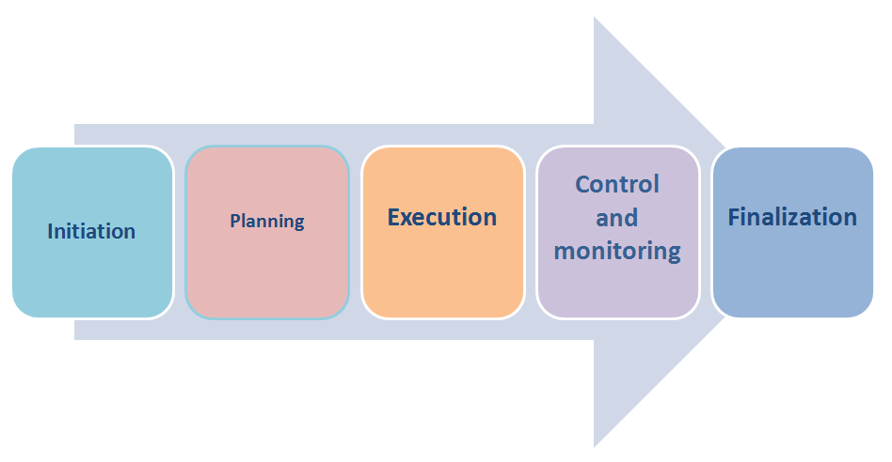
PMBoK: process groups

Slide 18
Initiation
Organization maturity level and the types of projects
Manager roles
Stakeholders: Focus Area
Stages of team development
Team roles in the project
Selection of project participants.

Slide 19
Planning
Project planning pyramid. The basic levels: vision, mission.
Goals setting. The SMART rule.
Charter of the project
SWAT analysis
Graphical Planning Methods
Management of risks

Slide 20
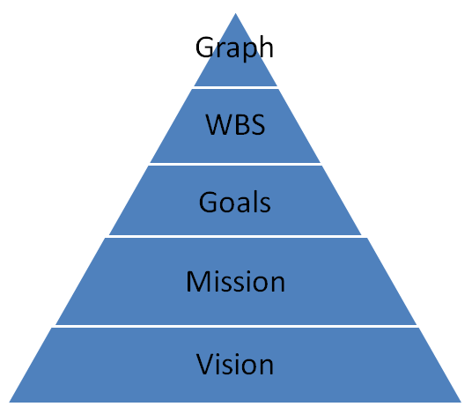
Project planning pyramid
Work Breakdown Structure, WBS - list of the work that needs to be done to achieve the project objectives

Slide 21
SMART principle
Specific
Measurable
Achievable
Result-oriented -not on effort (process);
Time-based - determined by the time of execution.

Slide 22
SWOT analysis
Strength - Strengths of the organization,
Weakness - the weaknesses of the organization,
Opportunities - capabilities,
Treatment - threatening dangers.

Slide 23
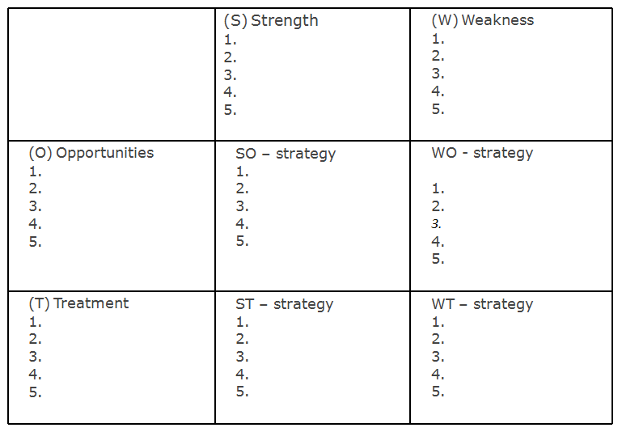
SWOT analysis

Slide 24
Risk management
Identify risks
Estimate the impact
What to do to prevent the risk?
What if the risk occurred?
Regularly monitor ricks

Slide 25
Вы – менеджер проектов в компании, специализирующейся на разработке программного обеспечения на заказ.Вы управляете проектом по созданию системы для государственного заказчика. Основная задача системы – формирование очереди детей в детские сады (родители заходят на специальный сайт, заполняют формы, и дети попадают в очередь). Помимо собственно регистрации детей, система выполняет множество дополнительных функций – собирает статистику, интегрируется с другими системами и т.д. Ваш проект должен быть выполнен за 7 месяцев. На прошлой неделе он перевалил за «экватор» и идет довольно гладко. Отставание от первоначального графика хоть и есть, но не очень существенно (неделя), и заказчик письменно подтвердил, что задержка возникла из-за его нерасторопности. У вас отличные отношения с заказчиком, он доверяет вам.Однажды утром к вам пришел один из ведущих программистов и предложил интересное техническое решение, которое позволит сократить время разработки на месяц. Вы не первый год знаете этого программиста, он очень опытный профессионал, и обычно все его предложения технически очень хороши.Как вы поступите?
А. Выиграть месяц – отличная идея, мы высвободим ресурсы для других проектов, да и хорошо бы получить дополнительное время на случай непредвиденных обстоятельств. Поэтому я принимаю предложение программиста.
В. Я подготовлю заявку на изменение и вынесу этот вопрос на обсуждение управляющего комитета. Все решения по изменению сроков проекта должны проходить через спонсора проекта и УК.С. Это предложение не может быть принято – мы все тщательно распланировали, все идет гладко, и никакие изменения нам не нужны. План есть план, зачем портить то, что работает?
D. Сначала я посоветуюсь с заказчиком. Если мы можем завершить проект раньше, это может быть большим плюсом и для нас как вендора в глазах заказчика и, возможно, для самого заказчика в глазах его начальства.
E. Сначала я должен все тщательно взвесить и оценить предлагаемое решение с точки зрения влияния на проект. Только после этого я смогу принять решение, что делать дальше.
F. Завтра же утром я соберу команду на совещание, и мы вместе обсудим это предложение. Наш проект прозрачен для всех участников, команда должна принять решение по этому вопросу.
http://psilonsk.livejournal.com/

Slide 26
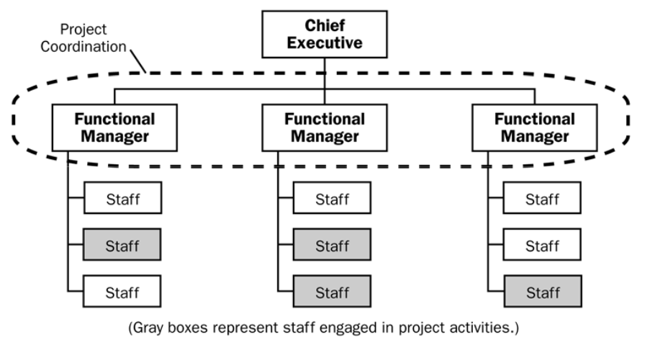
Functional organization

Slide 27
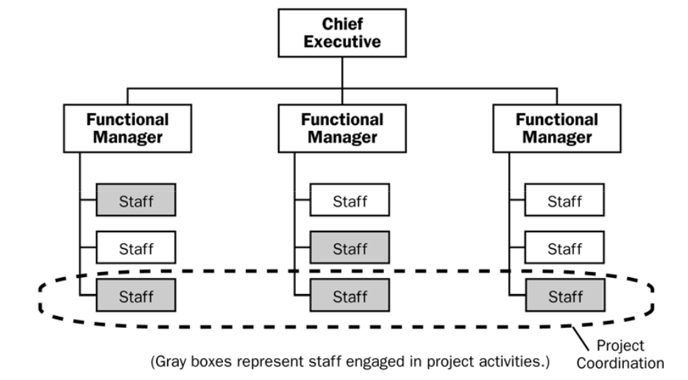
Weak matrix organization

Slide 28
Weak matrix organization

Slide 29
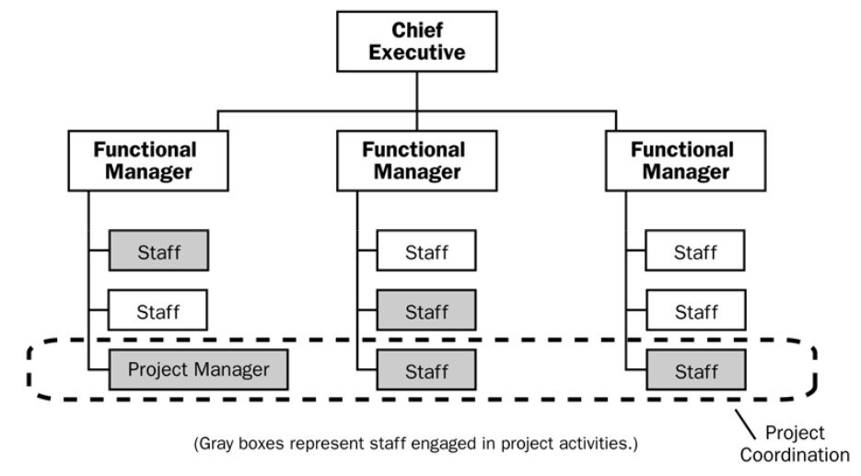
Balanced matrix organization

Slide 30
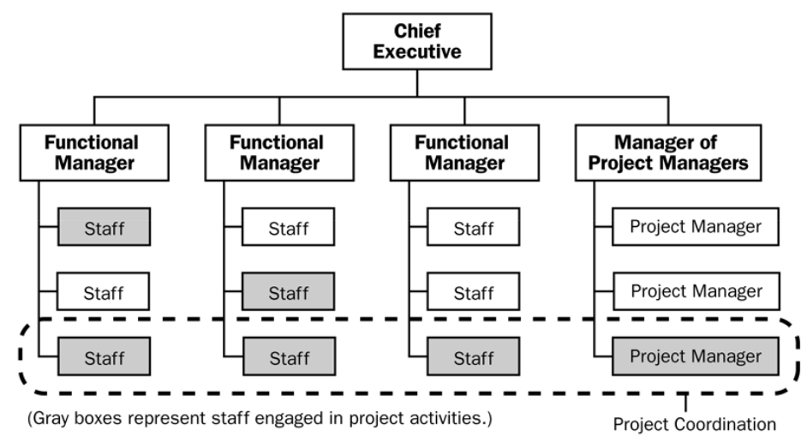
Strong matrix organization

Slide 31
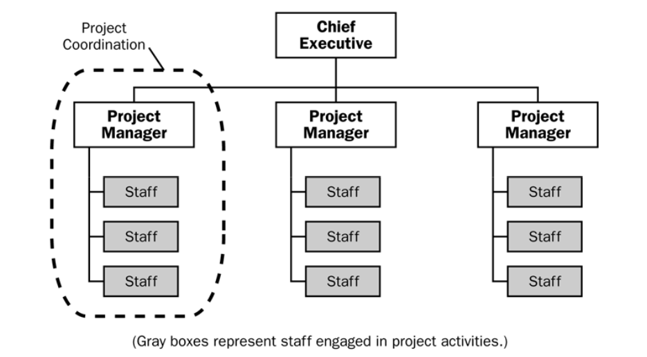
Project-like organization

Slide 32
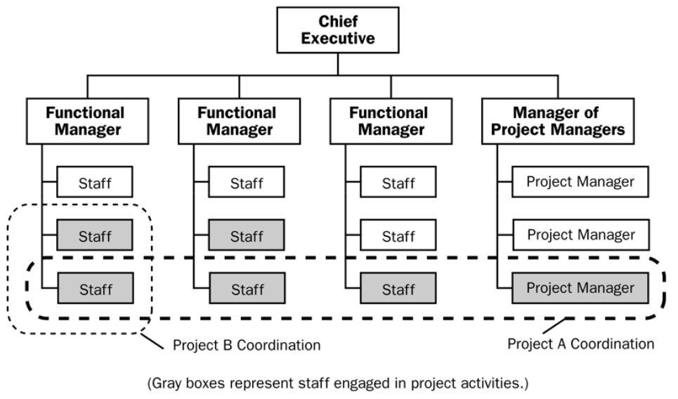
Combined organization

Slide 33
Project processes
The organization’s processes and procedures includes for
Initiating and Planning:
Guidelines and criteria for tailoring the organization’s set of standard processes and procedures to satisfy the specific needs of the project;
Specific organizational standards such as policies (e.g., human resources policies, health and safety policies, ethics policies, and project management policies), product and project life cycles, and quality policies and procedures (e.g., process audits,improvement targets, checklists, and standardized process definitions for use in the organization);
Templates (e.g., risk register, work breakdown structure, project schedule network diagram, and contract templates).

Slide 34
Project processes
The organization’s processes and procedures includes for
Executing, Monitoring and Controlling:
Change control procedures, including the steps by which performing organization standards, policies, plans, and procedures or any project documents will be modified, and how any changes will be approved and validated;
Financial controls procedures (e.g., time reporting, required expenditure and disbursement reviews, accounting codes, and standard contract provisions);
Issue and defect management procedures defining issue and defect controls, issue and defect identification and resolution, and action item tracking;

Slide 35
Project processes
The organization’s processes and procedures includes for
Executing, Monitoring and Controlling:
Organizational communication requirements (e.g., specific communication technology available, authorized communication media, record retention policies, and security requirements);
Procedures for prioritizing, approving, and issuing work authorizations;
Risk control procedures, including risk categories, risk statement templates, probability and impact definitions, and probability and impact matrix;
Standardized guidelines, work instructions, proposal evaluation criteria, and performance measurement criteria.

Slide 36
Project processes
The organization’s processes and procedures includes for
Closing:
Project closure guidelines or requirements (e.g., lessons learned, final project audits, project evaluations, product validations, and acceptance criteria).

Slide 37
Сorporate Knowledge Base
The organizational knowledge base for storing and retrieving information includes, but is not limited to:
• Configuration management knowledge bases containing the versions and baselines of all performing organization standards, policies, procedures, and any project documents;
• Financial databases containing information such as labor hours, incurred costs, budgets, and any project cost overruns;
• Historical information and lessons learned knowledge bases (e.g., project records and documents,
all project closure information and documentation, information regarding both the results of previous project selection decisions and previous project performance information, and information from risk management activities);
• Issue and defect management databases containing issue and defect status, control information, issue and defect resolution, and action item results;
• Process measurement databases used to collect and make available measurement data on processes and products;
• Project files from previous projects (e.g., scope, cost, schedule, and performance measurement baselines, project calendars, project schedule network diagrams, risk registers, planned response actions, and defined risk impact).

Slide 38
Project Governance
Examples of the elements of a project governance framework include:
• Project success and deliverable acceptance criteria;
• Process to identify, escalate, and resolve issues that arise during the project;
• Relationship among the project team, organizational groups, and external stakeholders;
• Project organization chart that identifies project roles;
• Processes and procedures for the communication of information;
• Project decision-making processes;
• Guidelines for aligning project governance and organizational strategy;
• Project life cycle approach;
• Process for stage gate or phase reviews;
• Process for review and approval for changes to budget, scope, quality, and schedule which are beyond
the authority of the project manager;
• Process to align internal stakeholders with project process requirements.

